Slide 1
CMPT-439 Numerical Computation
Fall 2020
Solving Systems of Linear Equations
Iterative Methods

Slide 2
Systems of Linear Equations
In a matrix form:

Slide 3
Iterative Methods
Any elimination method is a direct method, that is a method resulting in a solution after a single step of transformations applied in general to all equations
Iterative methods are alternatives to the direct ones
In an iterative method, we estimate the solution and then proceed step by step to refine this estimate

Slide 4
Diagonally Dominant System
A system Ax=b of n linear equations in n unknowns is called diagonally dominant when each diagonal entry of the coefficient matrix is larger in magnitude than the sum of the magnitudes of the other coefficients in that row:

Slide 5
Diagonally Dominant System
The Iterative methods work for those systems, which are diagonally dominant (this is a sufficient condition for convergence of an iterative method and it is very important that a system is diagonally dominant, because the algorithm may not converge otherwise! )
If a system is not diagonally dominant, its equations usually can be re-ordered in such a way that it becomes diagonally dominant
For example:

Slide 6
Iterative Methods
To solve the system Ax=b iteratively, it must be reshaped by solving the first equation for x₁, the second equation for x₂, the third one for x₃, …and the n^{th} equation for x_{n}

Slide 7
Iterative Methods
or, which is the same:
… … …

Slide 8
Iterative Methods
In other words:
From Equation 1
From equation 2
From equation n-1
From equation n

Slide 9
Iterative Methods
The main idea behind the iterative methods is as follows:
We begin with some initial approximation to the values of our unknowns (they can be arbitrarily taken)
Substituting these approximations into the right-hand sides of the reshaped system of equations, we generate new approximations in the left-hand side that, we hope, are closer to the solution

Slide 10
Iterative Methods
Two most known and frequently used iterative methods are the Jacobi method and the Gauss-Seidel method
Both these methods employ the approach, which was presented above
Their distinction is as follows:
In the Jacobi method, the i^{th} iteration consists of finding a new approximation based on the previous approximation
In the Gauss-Seidel method, the i^{th} iteration consists of finding a new approximation based on the latest currently available values of

Slide 11
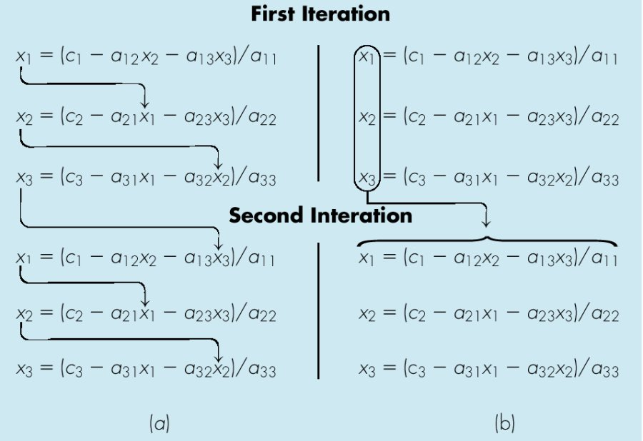
Illustration of the Gauss-Seidel and Jacobi methods for 3 equations
Gauss-Seidel:
Jacobi:

Slide 12
Iterative Methods: convergence
Any iterative method converges when a current approximate error drops below some pre-determined tolerance value
We may use in our implementations mean absolute error (MAE), that is
Or root mean square error (RMSE), that is
where i is the number
of the current iteration

Slide 13
Jacobi Method: Algorithm
Wherever it is possible, rearrange the system Ax=b to make its matrix diagonally dominant
for i=1 to n
b(i)=b(i)/a(i,i)
new_x(i)=starting value(i)
for j=1 to n
if (i~=j)
then a(i,j)=a(i,j)/a(i,i)
end if
end for j
end for i
error=10 % this is just to start the while loop below
while (error>tolerance)
error=0
for i=1 to n
old_x(i)=new_x(i)
new_x(i)=b(i)
end for i
for i=1 to n
for j=1 to n
if (i~=j)
then new_x(i)=new_x(i)-a(I,j)*old_x(j)
end if
end for j
error=error+abs(new_x(i) - old_x(i)) % mean absolute error
end for i
error=error/n % mean absolute error
end while

Slide 14
Gauss-Seidel Method: Algorithm
Wherever it is possible, rearrange the system Ax=b to make its matrix diagonally dominant
for i=1 to n
b(i)=b(i)/a(i,i)
x(i)=starting value(i)
old_x(i) = x(i)
for j=1 to n
if (i~=j)
then a(i,j)=a(i,j)/a(i,i)
end if
end for j
end for i
error=10 % this is just to start the while loop below
while (error>tolerance)
error=0
for i=1 to n
x(i)=b(i)
for j=1 to n
if (i~=j)
then x(i)=x(i)-a(i,j)*x(j)
end if
end for j
error=error+abs(x(i) - old_x(i)) % mean absolute error
old_x(i)=x(i)
end for i
error=error/n % mean absolute error
end while

Slide 15
Jacobi vs. Gauss-Seidel
The Gauss-Seidel method usually converges faster than the Jacobi method
It is important to take into account that if the system matrix is not diagonally dominant, the iterative method may not converge
Hence it is very important to start any iterative algorithm from making a matrix of a system diagonally dominant!

Slide 16
Gauss-Seidel Method: Example
Given the system of equations
The coefficient matrix is:
With an initial guess of
Will the solution converge using the Gauss-Siedel method?

Slide 17
Gauss-Seidel Method: Example
Checking if the coefficient matrix is diagonally dominant
The inequalities are all true
Therefore: The Gauss-Seidel Method should vonverge
Let us use MAE tolerance value 0.003 to stop our iterative process

Slide 18
Gauss-Seidel Method: Example
Rewriting each equation
With an initial guess of

Slide 19
Gauss-Seidel Method: Example
The absolute approximate errors are
The mean absolute error = (er1+er2+er3)/3=2.4974

Slide 20
Gauss-Seidel Method: Example
After Iteration #1
Substituting the x values into the equations
After Iteration #2

Slide 21
Gauss-Seidel Method: Example
Iteration #2 absolute relative approximate error
The mean absolute error = (er1+er2+er3)/3=0.7522

Slide 22
Gauss-Seidel Method: Example
Repeating more iterations, the following values are obtained
Iteration | x₁ |  | x₂ |  | x₃
1 2 3 4 5 6 | 0.50000 0.14679 0.74275 0.94675 0.99177 0.99919 | 0.5 0.3523 0.5960 0.2038 0.0450 0.0074 | 4.9000 3.7153 3.1644 3.0281 3.0034 3.0001 | 4.9 1.1847 0.5509 0.1363 0.0247 0.0033 | 3.0923 3.8118 3.9708 3.9971 4.0001 4.0001 | 2.0923 0.7195 0.1590 0.0263 0.0030 0.00
MAE=0.003
The solution obtained is close to the exact solution of .

